Slide 1
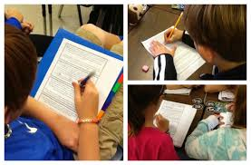
A Closer Look at Close Reading

Slide 2
Essential Question:
How do we get students engaged in complex text?
Objective:
At the end of this presentation I will have a better understanding of Close Reading.

Slide 3
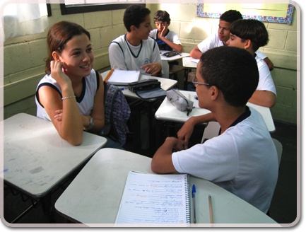
What is Close Reading?
Think, Pair, Share

Slide 4
To read closely means to gain the meaning of the text and how it works from an analysis of the text itself, with little or no outside information. Such reading includes reading and rereading.
Timothy Shanahan

Slide 5
True or False

Slide 6
FIRST READ: KEY IDEAS AND DETAILS
-Set the purpose for reading.
-Students read text as independently as possible.
-The first read should be without building background.
-Focus should be on the key ideas and details in the text.
(main idea, story elements, or key details)
-Following the first read, have students Think-Pair-Share
to assess what they have gleaned from the text.

Slide 7
SECOND READ: CRAFT AND STRUCTURE
-This reading focuses on text features, organizational patterns and content vocabulary the author included.
-Students reread selected text focusing on text dependent question.
-Students use pencils, highlighters, or post-its to mark the text.
-After rereading, students discuss the text with partners or in small groups, focusing on the author’s craft and organizational patterns.
-After students share with partners or in small groups, have groups share out with entire class to assess understanding.

Slide 8
THIRD READ: INTEGRATION OF KNOWLEDGE AND IDEAS
-The third close reading of a text should go even deeper, requiring students to synthesize and analyze information based on a text dependent question.
-The focus is on what the text means to the reader and how it connects to other experiences.
-The students use pencils, highlighters, or post-its to mark the text.
-Discuss the text evidence in response to the text dependent question.
-Students respond in writing. Seeing the responses in writing will help the teacher assess the students level of understanding.

Slide 9
READ WITH A PENCIL
Number the paragraphs
Chunk the text
Underline and circle… with a purpose.
Left margin: What is the author SAYING? (short summary)
Right margin: Dig deeper into the text

Slide 10
Resources for Close Reading
One Page Online Reading Passages
ReadWorks.org
Close Reading with Text Dependent Questions

Slide 11
Middle School Article of the Week
Opinion Pages…Room for a Debate
Awesome Stories

Slide 12
Close Reading Template

Slide 13
Close Reading Lessons

Slide 14
A text dependent question specifically asks a question that can only be answered by referring explicitly back to the text being read.
Text Dependent Question Samples

Slide 15
Close Reading Video
5th grade students use Close Reading strategies to determine the main idea and important details from a newspaper.

Slide 16
Close Reading Video
This video shows second graders reading complex text about communities.
Close Reading Video
This video shows a teacher using Close Reading with an Interactive Read Aloud about Gorillas. (grades 3-5)

Slide 17
Essential Question:
How do we get students engaged in complex text?
Objective:
At the end of this presentation I will have a better understanding of Close Reading.

Slide 18
Next steps………….
RUSD training videos
Share passages with grade level
Evaluating text for Close Reading

